Slide 1
Customer Churn Prediction
-To Predict the Customer Churn in banking
Harish Jamallamudi
Balamurali B
Yenkatarajalaxmimanohar Meda
Amruth Reddy Nagireddy Palli
Sai Sreeja Yalamanchi
Anirudh Boddu

Slide 2
Content
Title and Author
Content
Contribution
Data Description
Data Attributes
References

Slide 3
Contributions
Harish Jamallamudi :- I made contributions by developing the plots
and preparing the presentations.
Balamurali B :- I have contributed in data pre-processing
and interpreting the results.
Yenkatarajalaxmi Manohar Meda :- I was involved in making the plotting the
graphs for all the projects.
Amruth Reddy Nagireddy Palli :- I was active in interpreting the results.
Sai Sreeja Yalamanchi :- I am involved in making the ML models.
Anirudh Boddu :- I am active in making the models to improve
the accuracy of the model.

Slide 4
Data Description
This dataset includes details regarding the banking services and products the customer holds with the bank. This may encompass information about the kind of accounts they have like savings or checking accounts as their credit cards, loan accounts, and any other financial products they utilize. Moreover, it could also consist of data related to their transaction history, such as how they make transactions the amount of money deposited or withdrawn, and the specific types of transactions they engage in. Collectively this data can provide insights into how involved the customers are with the bank.
The dataset is available at : https://www.kaggle.com/datasets/shubh0799/churn-modelling

Slide 5
Data Attributes
RowNumber
CustomerId
Surname
CreditScore
Geography
Gender
Age
Tenure
Balance
NumOfProducts
HasCrCard
IsActiveMember
EstimatedSalary
Exited

Slide 6
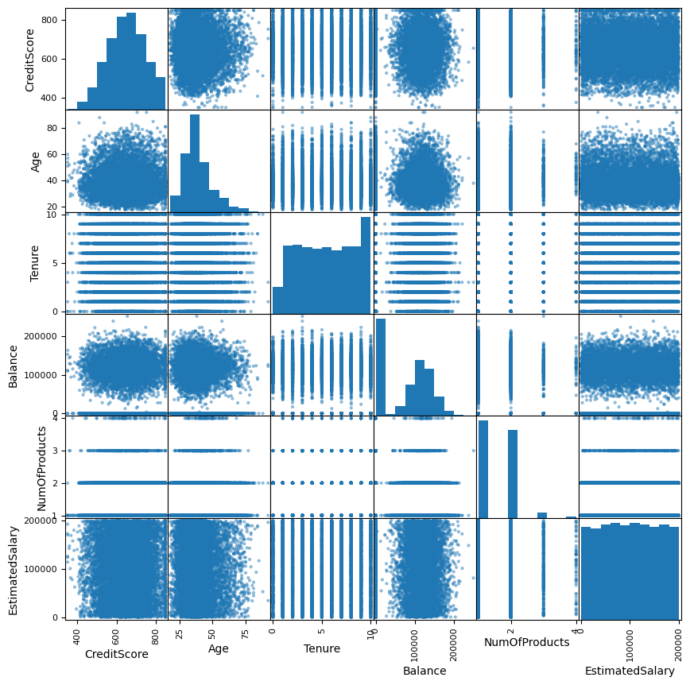
SCATTER PLOT

Slide 7
Interpretation
Scatter plot is used to find the relationship between features like linear relationship or non linear relationship and clusters etc. From above scatter plot on the quantitative data from dataset “churn modelling”, we decided to remove age because, it has linear relationship between credit score and age, and credit score has gaussian curve. Remaining attributes present in dataset are
Qualitative
Quantitative
Geography
Gender
HasCrCard
IsActiveMember
Exited
CreditScore
Tenure
Balance
NumOfProducts
EstimatedSalary

Slide 8
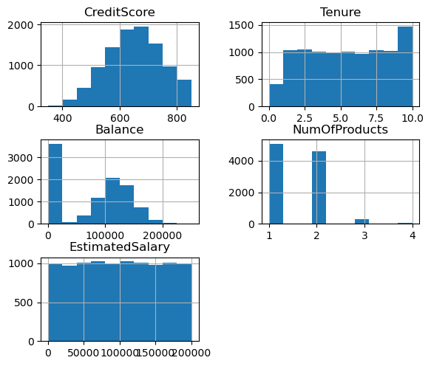
HISTOGRAMS

Slide 9
Interpretation
A histogram is an effective way to display numerical data grouped into intervals. It provides a visual representation of data distribution, using bars to depict the frequency of values within each interval. The X-axis shows the intervals (bins), while the Y-axis represents the frequency of data falling into those bins.
Histogram of Credit Score is symmetric unimodal, as it has normal distribution
Histogram of Tenure is Uniform because every value in a specified range has equal probability of occurring
Histogram of Balance is symmetric with left skewed as majority of data is at centre but one outlier at left
Histogram of Estimated Salary is Uniform as it has no peaks or tail as it is same for entire time
Histogram of NumOfProducts is Discrete Distribution at most three products.

Slide 10
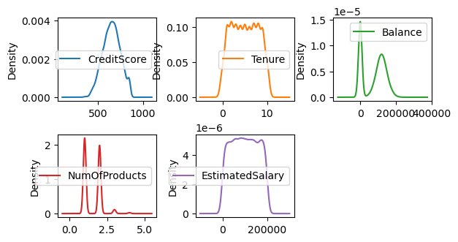
Density Plot

Slide 11
Interpretation
A density plot, a form of data visualization, employs 'kernel smoothing' to depict a smooth, continuous version of a histogram derived from the dataset.
The x-axis represents the values of the specified columns:CreditScore, Tenure,Balance,
NumOfProducts, and EstimatedSalary.
The y-axis represents the density of these values, indicating how frequent these values occurs in the dataset.
Each curve represents the density plot for a specific column, showing the distribution of values for the column. The areas under the curves represent the estimated probability density of the respective variables
The density plot provides insights into distribution and concentration of values for each specified variable,helping to understand their probability density and patterns within the dataset.

Slide 12
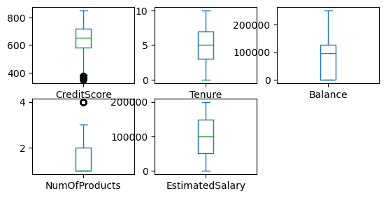
Box plot

Slide 13
INTERPRETATION
A Box Plot, often referred to as a Whisker plot, summarizes a dataset by displaying key properties: minimum, first quartile, median, third quartile, and maximum values. It uses a box to represent the interquartile range (from the first to the third quartile) and includes a vertical line at the median. The x-axis represents the data, while the y-axis shows the frequency distribution.
In credit score there are some outliers in the side of lower quartile and median exist far from at center of quartile and third quartile.
Four quartiles are equally distributed in Tenure, it has range of 10 starting from 0.
Balance and Number of products do not have lower values and no of products has median as lowest data point and starts from 0.
Alike Tenure, Estimatedsalary also has equally distributed values and range starts from 0 to 2 lakhs.

Slide 14
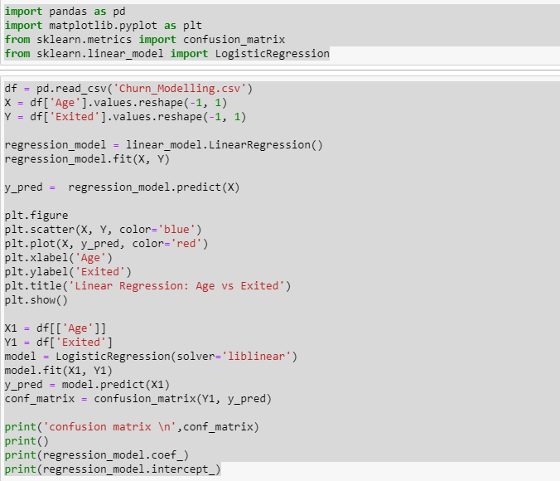
Code:

Slide 15
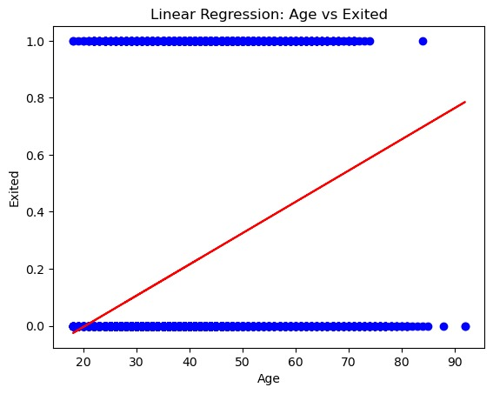
Confusion Matrix
7677 | 286
1964 | 73
7677 are correctly predicted as 0 using x, 286 predictions are wrongly corrected as 1 when it is 0, 1964 are wrongly predicted as 0 when they are 1, and finally 73 correctly predicted as 1.
The linear regression plot determines that all the data is just distributed either at 0 or 1 means. People leave irrespective of age. And this output cannot be determined using linear regression. Linear equation for above line is y=0.01095741x-0.22278197

Slide 16
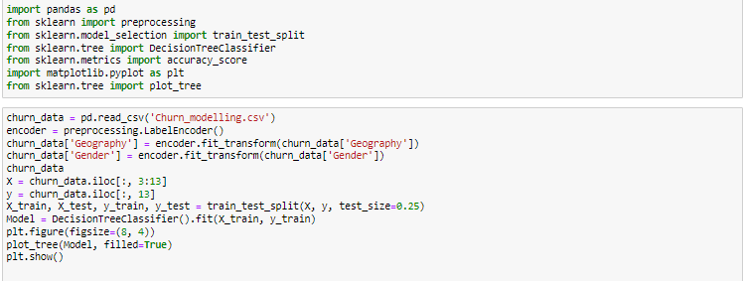
Code:

Slide 17
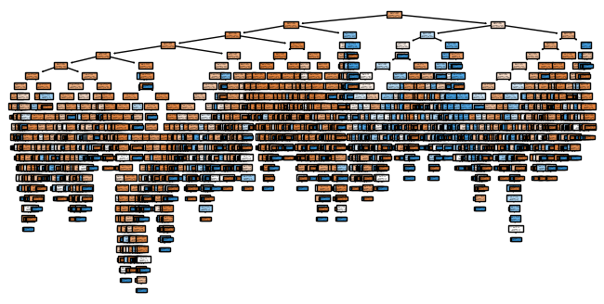
Here, the decision tree is very vast and got accuracy for testing data as 77%, So, Decision tree can satisfy the prediction of person whether he is gonna exit from bank or not with 0.77 probability. We can go with other models to improve accuracy furthermore. But Decision tree started its root nood gini value as 0.3263 which is relatively very less impure dataset, so, decision tree can respond very good for required prediction.

Slide 18
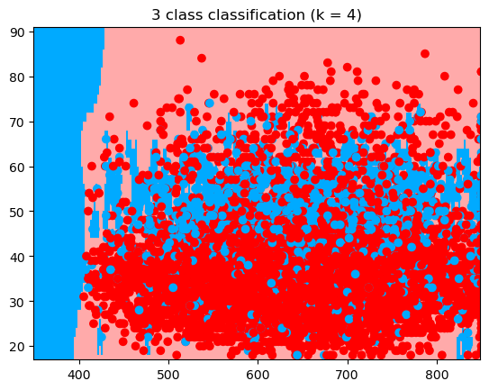
KNN
The KNN elbow graph shows accuracy stabilizing as the number of neighbors increases, peaking at k=4. It suggests that a low k value may lead to overfitting, as evidenced by the initial volatility. A higher k value, up to 20, maintains a consistent accuracy, indicating good model generalization. In this classification graph we can see the data has clustered based on 4 nearest neighbors , but it has mix of clusters which is very difficult of get our favourable outcomes. we are decided to not to use this model for our project, because it has very less fluctuation when data from other cluster pointed.

Slide 19
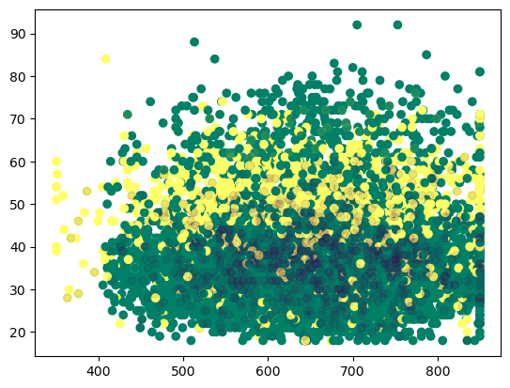
Graph of Naive Bayes
The scatter plot compares the Naïve Bayes model predictions against the actual class outcomes. As we can see ‘X’ marks inside the train data cluster so, it is giving good accuracy, but there are some outliers in train data, there gonna be some prediction errors. And from elbow graph test data accuracy got stable from best clusters 4, so these outliers need far down clustering, which is waste of computation power. So,we are determined that this model could not fir for our dataset and prediction

Slide 20
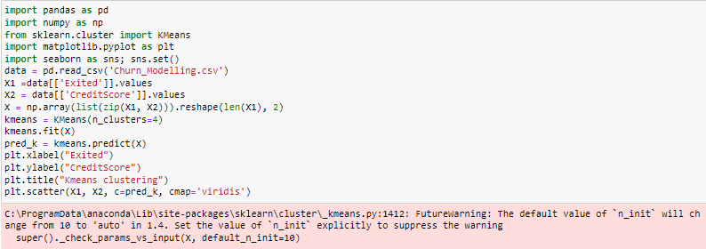
K Means Clustering
Code:

Slide 21
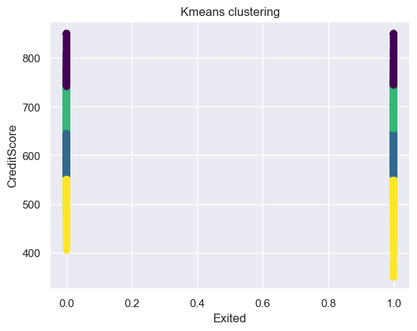
Graph of K Means Clustering
In our project there are only two outputs, so mostly clustering or classification do not suite with our dataset, We took X1 as “Exited” attribute and X2 as “CreditScore” which has total unique values 4, so we created total 4 clusters and given n_clusters as 4. Then after predicting , the predicted values provided the displayed graph which gave two horizontal lines with 4 cluster formats. But, it is not suitable for our dataset to predict the churn of financial sector, because of binary output. So, we are not proceeding with K Means clustering for predicting.

Slide 22
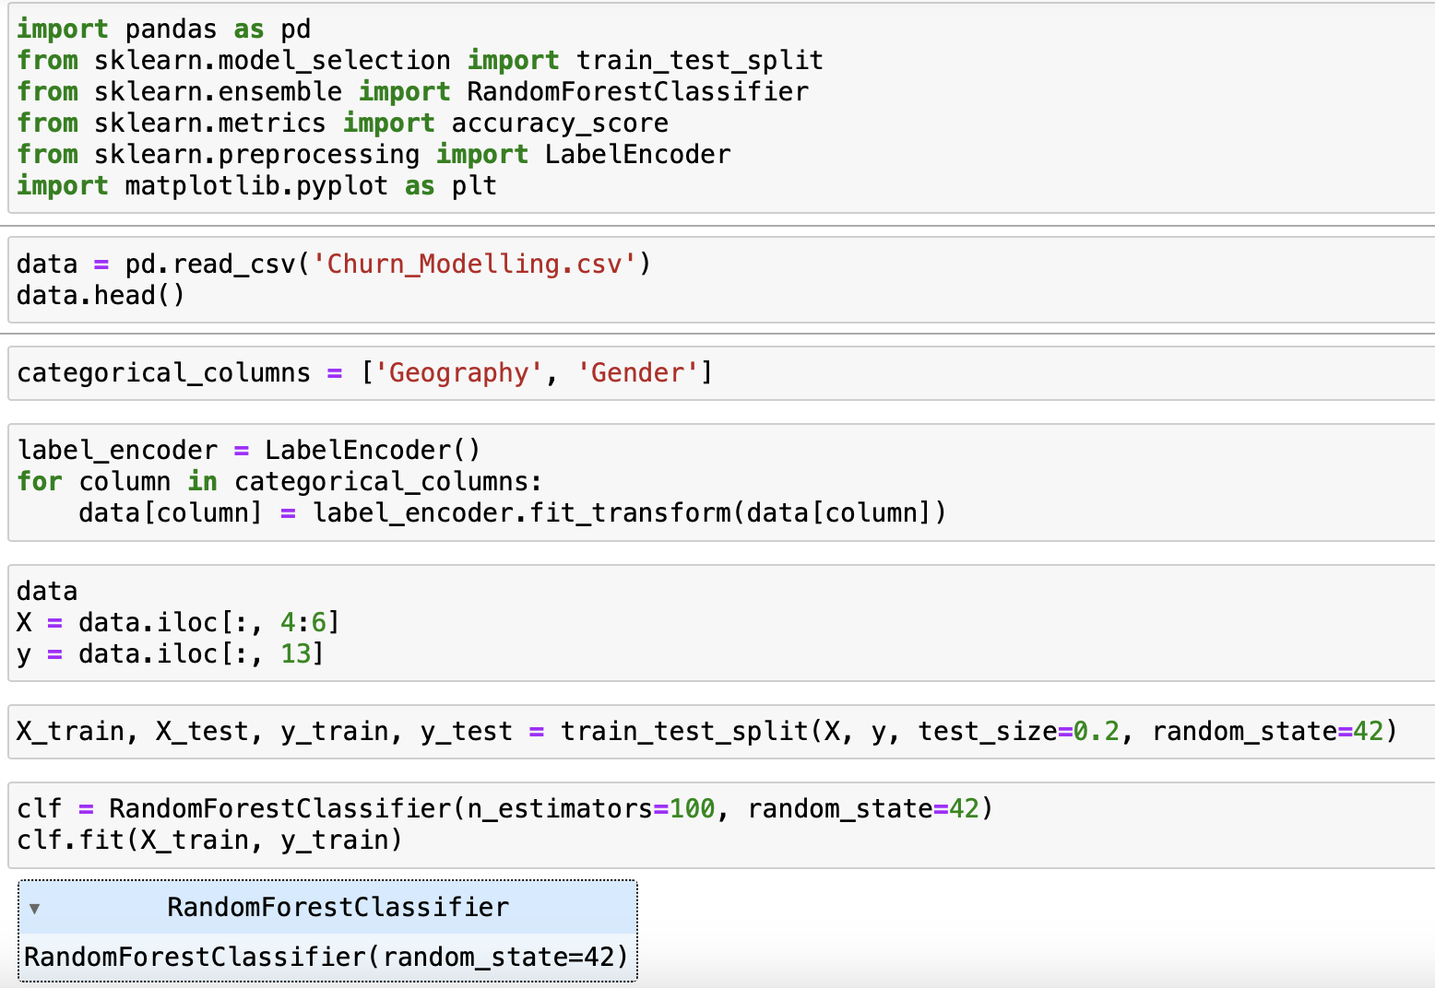
Random forest
Code:

Slide 23
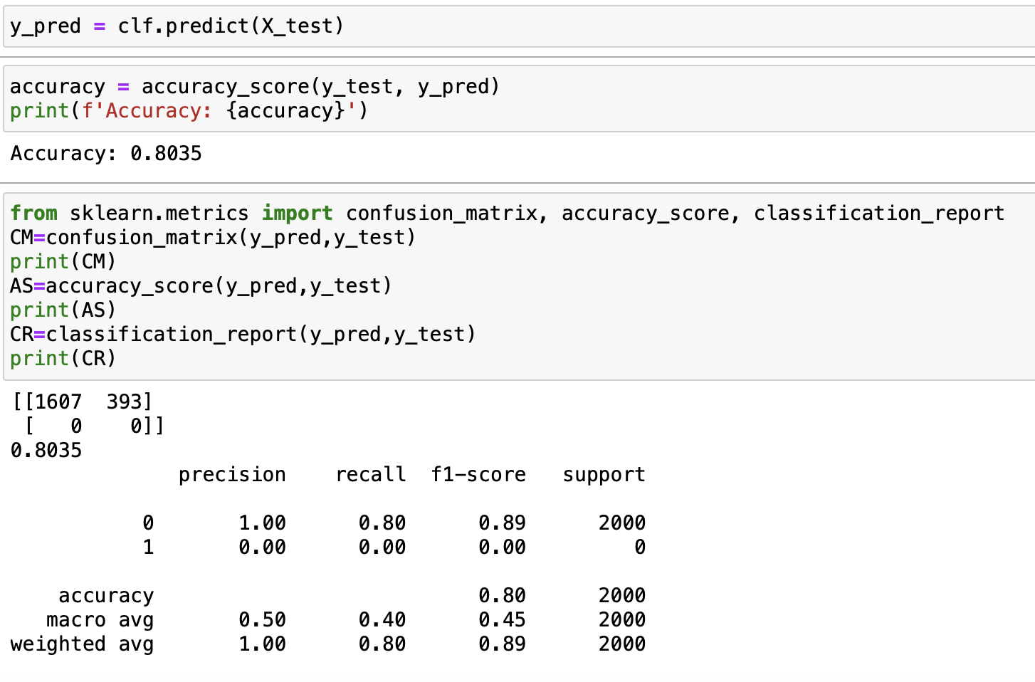
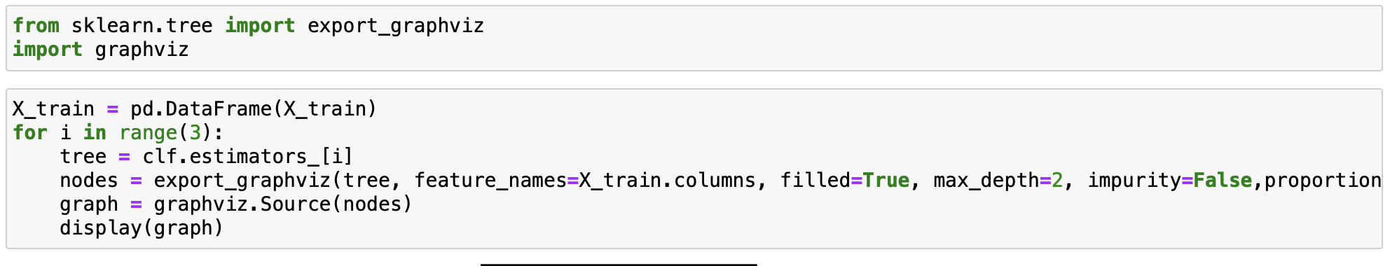

Slide 24
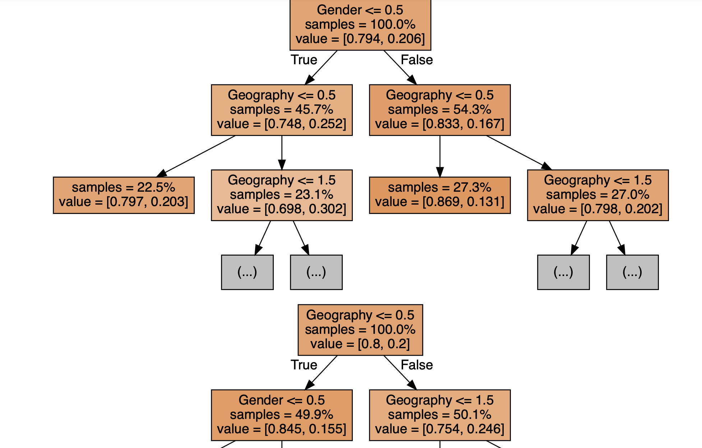
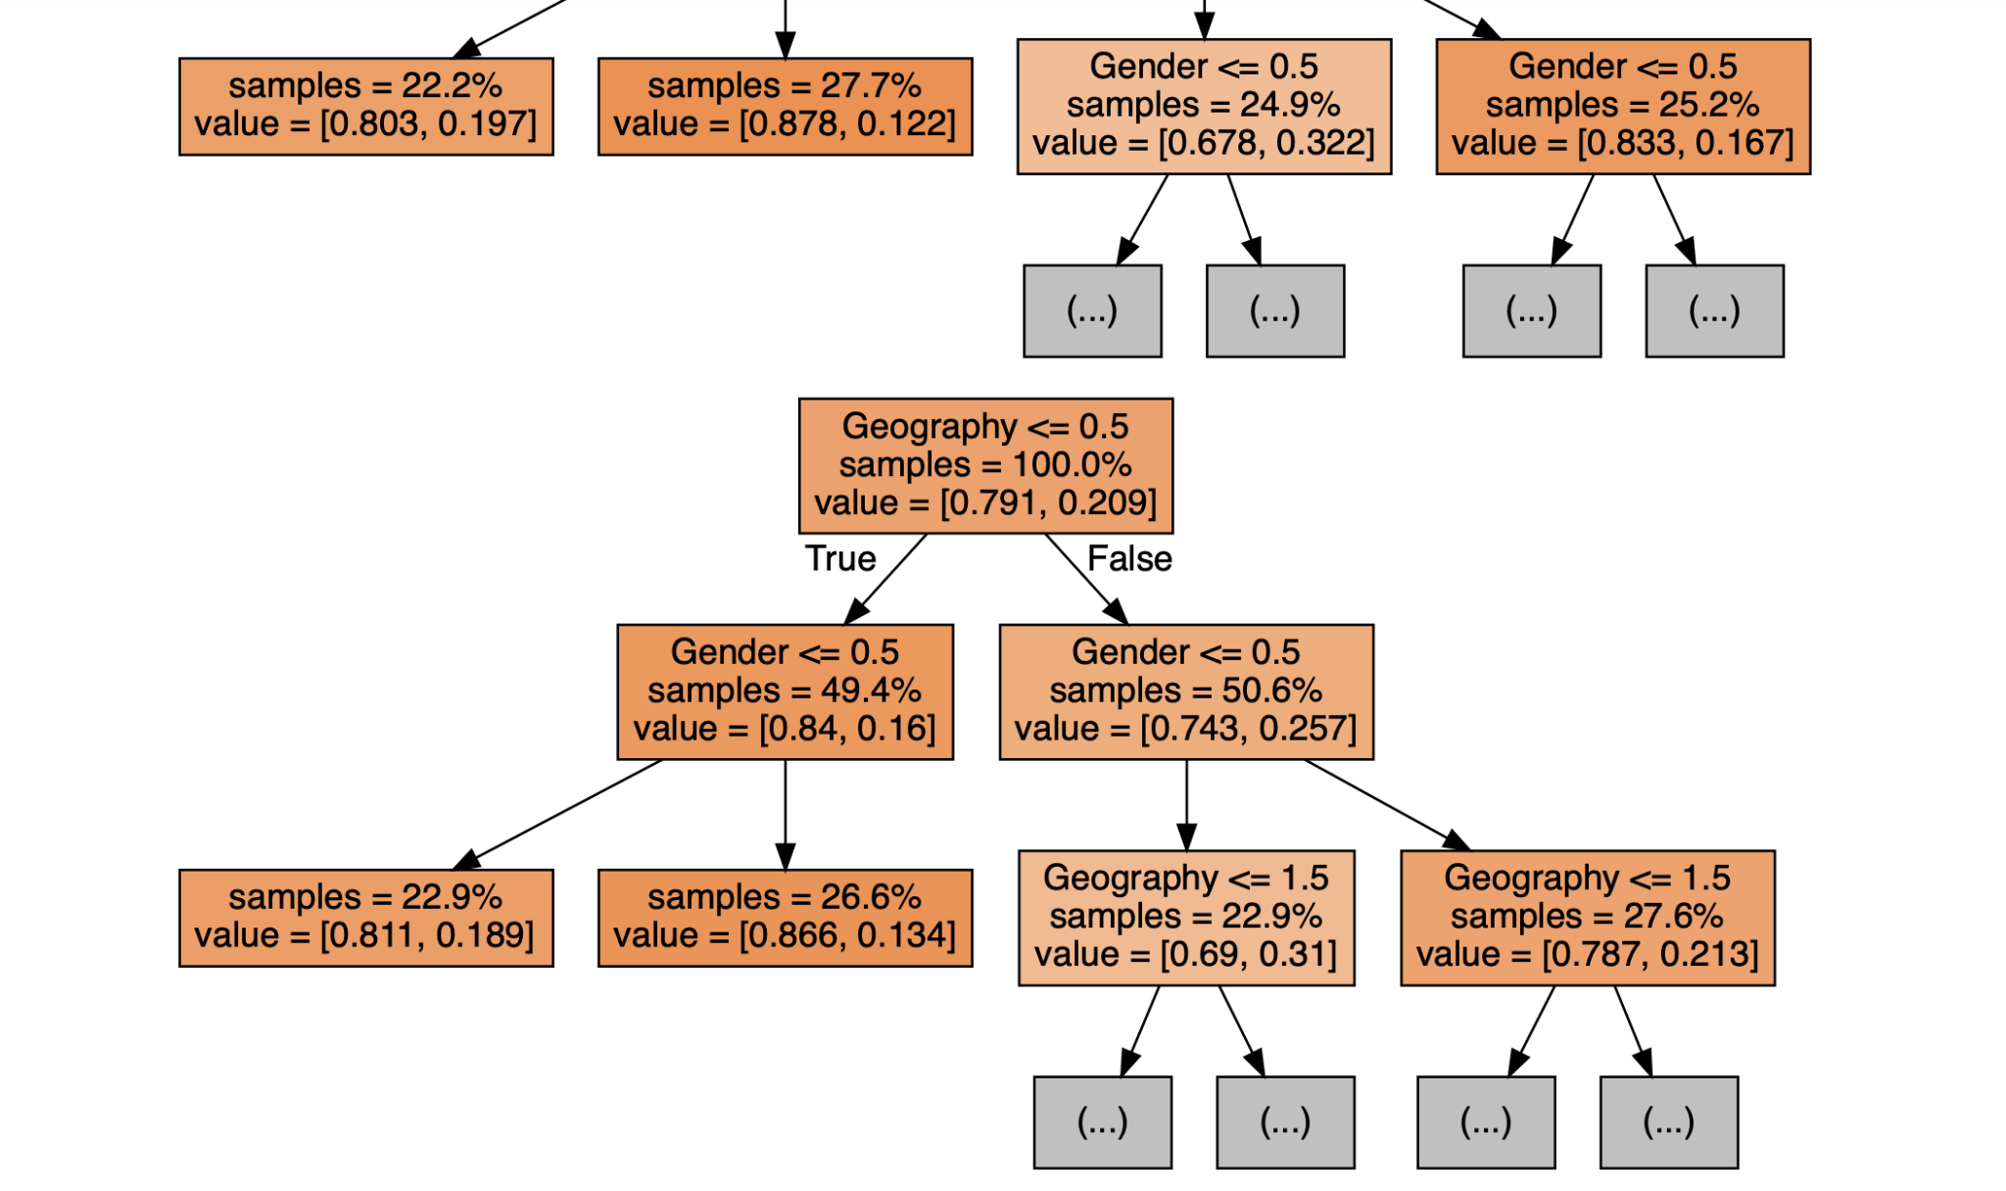
Random Forest Graph :
The Random Forest algorithm creates decision trees on data samples and then gets the prediction from each one of them and finally selects the best solution by means of voting. It is ensemble method which is better than single decision tree because it reduces the over-fitting by averaging the results.(Decision tree is more sensitive to training data). In our code we used 100 decision trees to finalize the output. So accuracy with 100 decision trees is 80.35%, whereas using only decision tree from previous week assignment we got 77% accuracy. So by comparing Decision tree and Random forest we can conclude Random Forest have good increased accuracy in predicting the output variable ‘Exited’.

Slide 25
Conclusions
The analysis of a banking dataset aimed at predicting customer churn revealed valuable insights. Key quantitative features, such as CreditScore, Tenure, Balance, NumOfProducts, and EstimatedSalary, were explored through histograms, density plots, and box plots. Relationships between features were visualized using scatter plots, leading to the removal of the 'Age' attribute.
The modeling phase included linear regression, decision trees, KNN, Naïve Bayes, K Means clustering, and Random Forest. Linear regression suggested a weak relationship, while decision trees and Random Forest emerged as promising for predicting customer churn, with Random Forest outperforming the single Decision Tree.
The dataset's binary nature (churn or no churn) influenced the choice of models, with ensemble methods proving effective. Random Forest achieved an 80.35% accuracy, surpassing the individual Decision Tree's 77%. The analysis provided insights into feature distributions and relationships, guiding the selection of relevant variables for modeling.

Slide 26
References
1.Soner Yıldırım, Churn Prediction with Machine Learning,Towards Data Science,2020
2. SIMGE EREK,A Machine Learning Model That Can Predict Customers Who Will Leave The Company,2020
3. Prabadevi, R. Shalini, B.R. Kavitha,Customer churning analysis using machine learning algorithms,International Journal of Intelligent Networks,2023

Slide 27
Thank You

